Slide 1
MDS 556
Webinar #1
October 25, 2016
Dr. Jim Kulich

Slide 2
Our Agenda for this Evening
Welcome Back
Overview of Our Course
An Introduction to Feature Engineering
Correlation – Variations on the Theme
The Chicken or the Egg – One Mathematical Approach to Causation
Conversation

Slide 3
MDS 556 Overview
Focus: Mathematical Tools for Building Better Models
Main Topics
Feature Engineering
Essentials of Linear Algebra and a little Calculus
Multiple Regression and its extensions
Time Series
Biological Methods – Neural Networks and Genetic Algorithms
Topics of interest to you
Approaches to What We Will Do
Mathematical perspective – application oriented but with a theoretical base
Stretch your mathematical comfort zone
Varied sources – including some academic papers
Data exercises – putting our ideas into action
Case studies
Final project – continue past work or try something new
Your suggestions are welcomed

Slide 4
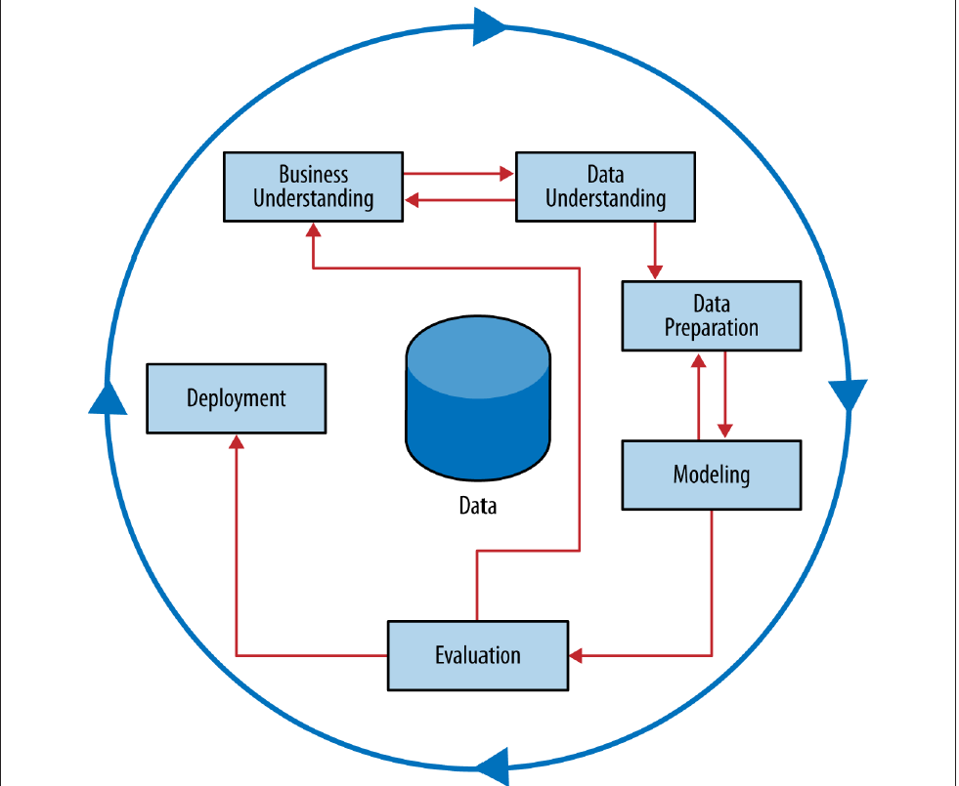
CRISP Data Mining Process
Data Science for Business: Chapter Two

Slide 5
MDS 556 – Possible Project Approaches
Individual: Develop and complete a project on a topic of your choosing with data you primarily assemble and use to create a model. We all provide support from an outside perspective.
Team: If several members of our group want to pursue a similar topic, you may work together as a team, but with explicitly defined roles and clear evidence of major contributions from each team member.

Slide 6
MDS 556 – Project Deliverables
Week One: Initial ideas
Week Three: Short project proposal – topic and any commentary that might be helpful for others to see
Week Eight: Technical presentation, Client presentation – action oriented
All Weeks: Questions, ideas to share, requests for help or feedback

Slide 7
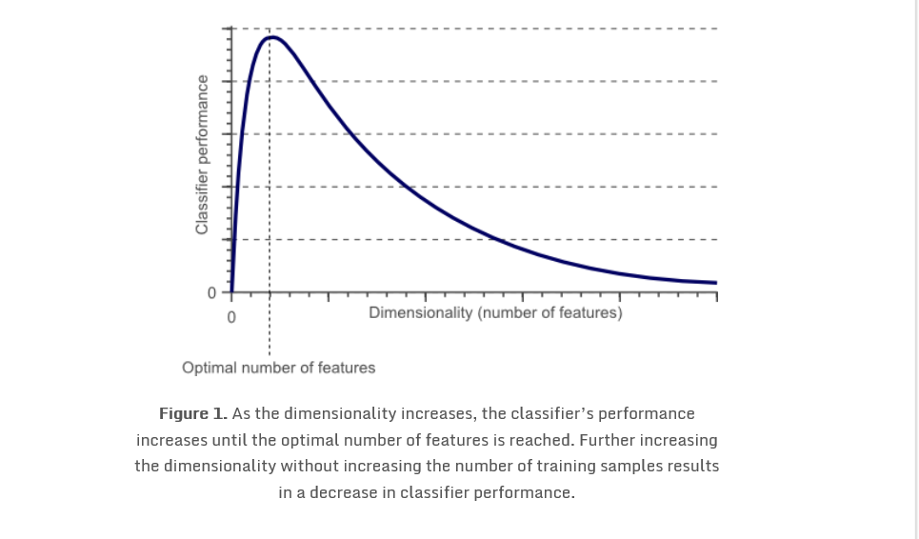

Slide 8
Feature Engineering
The process of transforming raw data into features that better represent the underlying problem to the predictive models, resulting in improved model accuracy on unseen data.
An attribute that is useful or meaningful to your problem.
Feature extraction - the automatic construction of new features from raw data (clustering, PCA)
Feature construction - the manual construction of new features from raw data (an art form)
Feature selection – from too many features to a few that are useful (ranking, scoring, algorithmic)
Feature learning – the automatic identification and use of features in raw data (new methods)
Working by hand vs. working at scale
https://www.kaggle.com/c/springleaf-marketing-response

Slide 9
Parametric and Non Parametric Correlation
X Y
1.0 1.0
2.4 2.0
3.8 2.3
4.0 3.7
11.0 2.5
X Y
1 1
2 2
3 3
4 5
5 4
R = .38
ρ = .9
R measures linearity
ρ measures monotonicity – data traveling in the same direction

Slide 10
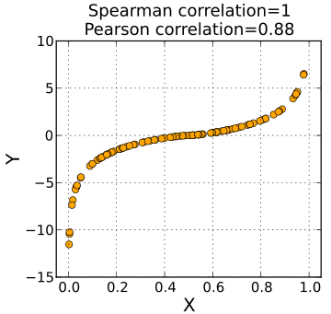
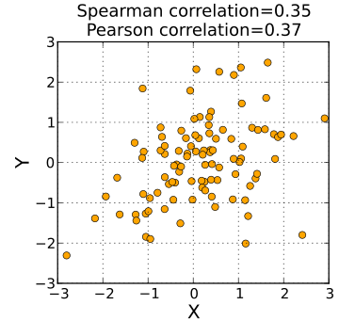
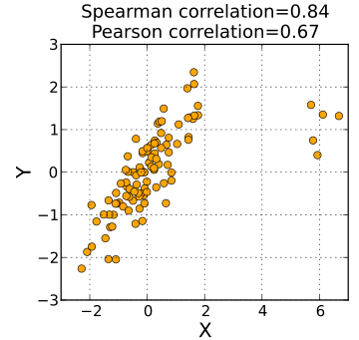
Source: Wikipedia

Slide 11
Vincent Granville – Five Conditions for a Good Correlation Metric
1.Independent of sample size to allow comparisons across buckets of different sizes: a correlation of (say) 0.6 must always correspond to (say) the 74-th percentile among all potential paired series (X, Y) of size n, regardless of n
2.Same bounds as old-fashioned correlation for back-compatibility : it must be between -1 and +1, with -1 and +1 attained by extreme, singular data sets, and 0 meaning no correlation
3.More general than traditional correlation: it measures the degree of monotonicity between two variables X and Y (does X grow when Y grows?) rather than linearity (Y = a + b*X + noise, with a, b chosen to minimize noise). Yet not as general as the distance correlation (equal to zero if and only if X and Y are independent) or my structuredness coefficient.
4.Not sensitive to outliers, robust
5.More intuitive, more compatible with the way the human brain perceives correlations

Slide 12
A Formula for Spearman’s Rank Correlation
s = 1 - S(X, Y)/q(n)
Where
S(X, Y) = SUM{ |x(j) - y(j)|^2 },
x(j), y(j) being the ranks of observation j, in the X and Y series,
q(n) = n*(n^2-1)/6,

Slide 13
A new family of rank correlations
Without loss of generality, from now on we can now assume that X is ordered and thus x(j) = j. Our new correlation will be denoted as t, or t(c) to emphasize the fact that it is a family of correlations governed by the parameter c.
The new correlation is computed as follows:
Step A
Compute u = SUM{ |x(j) - y(j)|^c}
Compute v = SUM{ |x(j) - z(j)|^c} where z(j) = n-1-y(j)
T = T(c) = min(u, v)
Sign = +1 if u<v, -1 if u>v, 0 if u=v
Step B
t = t(c) = Sign * { 1-T(c)/q(n) }
q(n) is the maximum value for T(c) computed across all (X, Y) with n observations

Slide 14
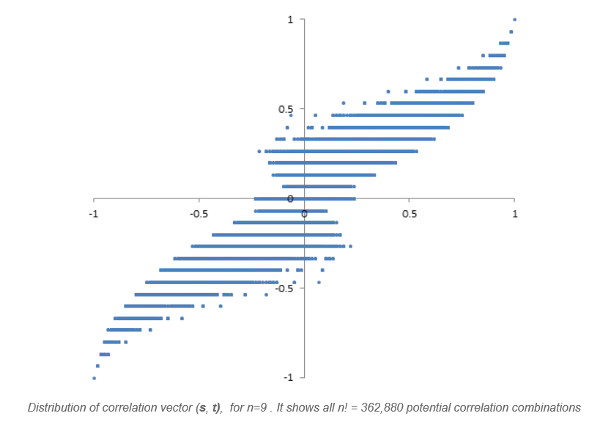

Slide 15
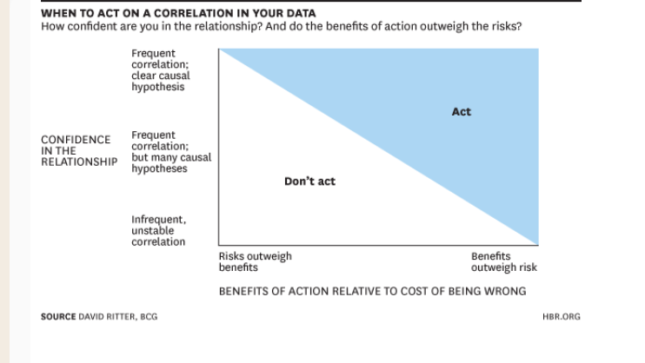

Slide 16
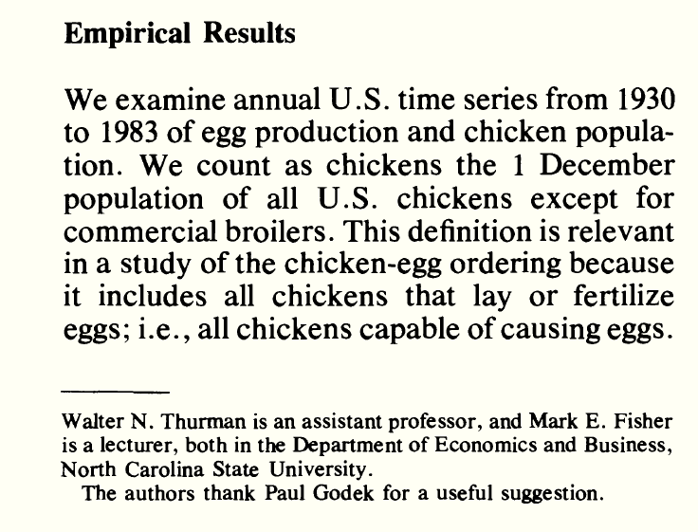
Thurman & Fisher, American Agricultural Economics Association, 1988

Slide 17
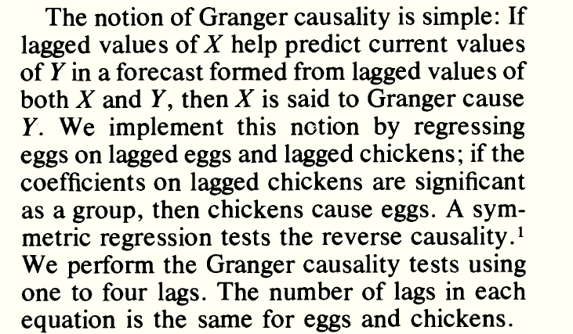

Slide 18
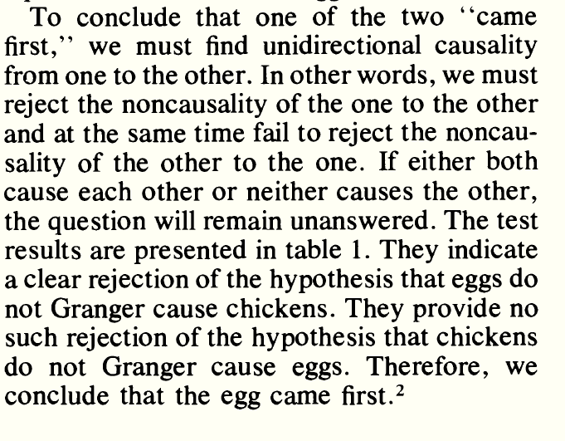

Slide 19
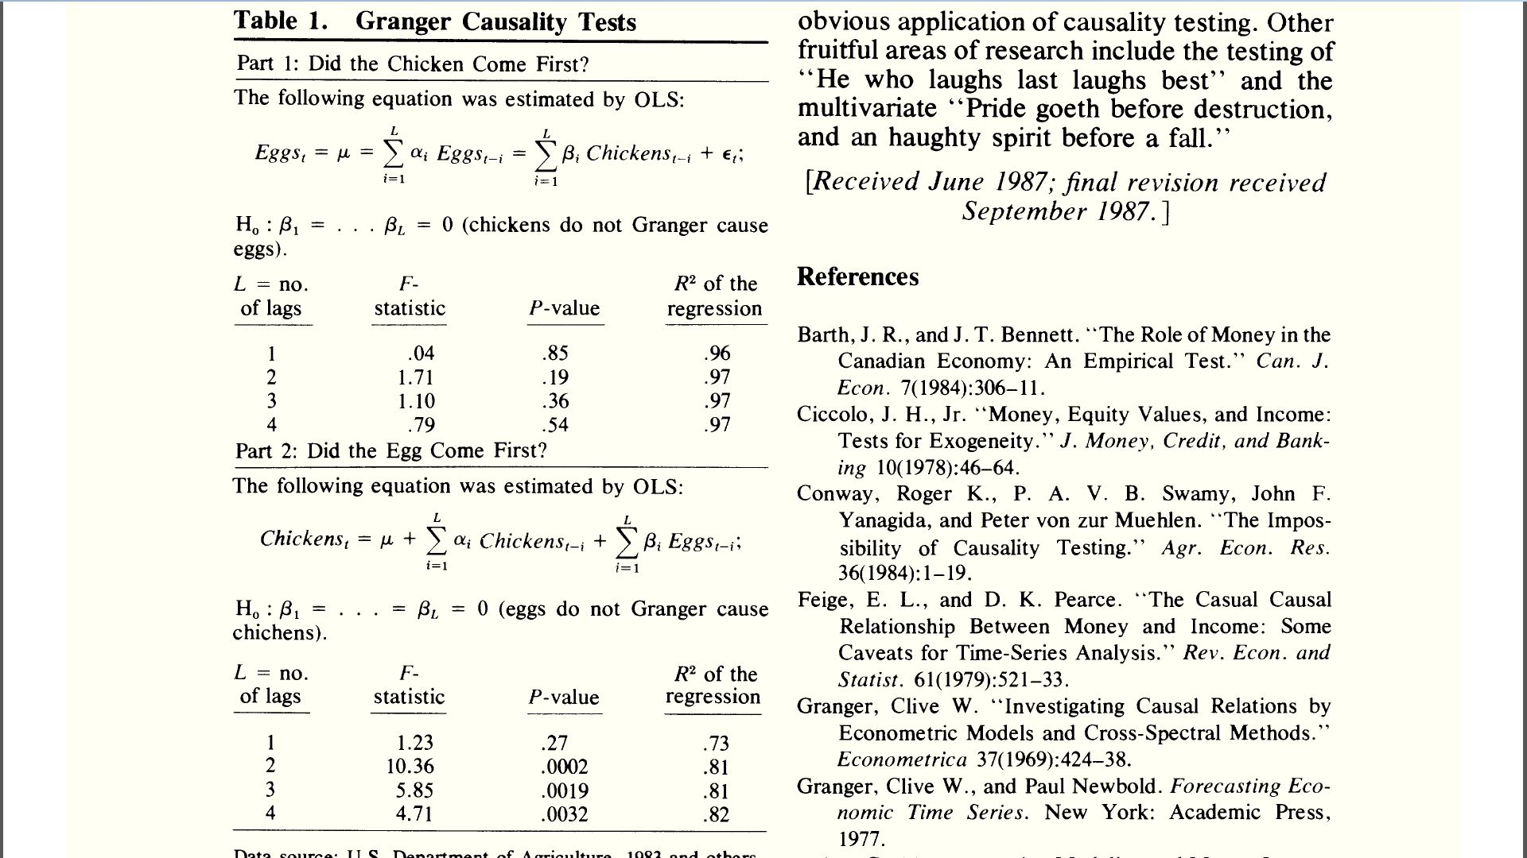

Slide 21
“If I had an hour to solve a problem and my life depended on the solution, I would spend the first 55 minutes determining the proper question to ask for once I know the proper question, I could solve the problem in less than five minutes.”
~Albert Einstein

